Slide 1
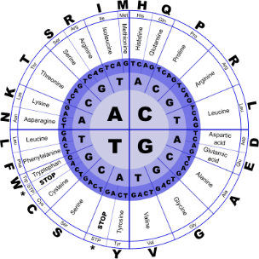
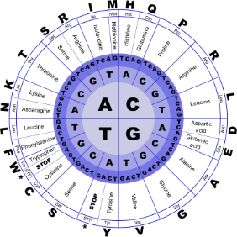


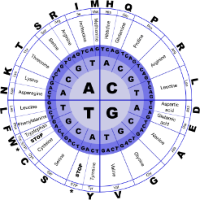
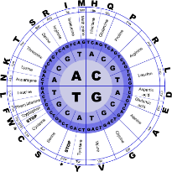
Fundamentals of Programming II
Linked List

Slide 2
Binary Trees
Binary tree: a nonlinear data structure in which each node may point to 0, 1, or two other nodes
The nodes that a node
N points to are the
(left or right)
children
of N
NULL
NULL
NULL
NULL
NULL
NULL

Slide 3
Terminology
If a node N is a child of another node P, then P is called the parent of N
A node that has no children is called a leaf node
In a binary tree there is a unique node with no parent. This is the root of the tree

Slide 4
Binary Tree Terminology
Root pointer: like a head pointer for a linked list, it points to the root node of the binary tree
Root node: the node with no parent
NULL
NULL
NULL
NULL
NULL
NULL

Slide 5
Binary Tree Terminology
Leaf nodes: nodes that have no children
The nodes containing 7 and 43 are leaf nodes
31
19
59
7
NULL
43
NULL
NULL
NULL
NULL
NULL

Slide 6
Binary Tree Terminology
Child nodes, children:
The children of the node containing 31 are the nodes containing 19 and 59
31
19
59
7
NULL
43
NULL
NULL
NULL
NULL
NULL

Slide 7
Binary Tree Terminology
The parent of the node containing 43 is the node containing 59
31
19
59
7
NULL
43
NULL
NULL
NULL
NULL
NULL

Slide 8
Binary Tree Terminology
The node containing 31 is the root
The nodes containing 19 and 7 form the left subtree
The nodes containing 59 and 43 form the right subtree
31
19
59
7
NULL
43
NULL
NULL
NULL
NULL
NULL

Slide 9
Uses of Binary Trees
Binary search tree: a binary tree whose data is organized to simplify searches
Left subtree at each node contains data values less than the data in the node
Right subtree at each node contains values greater than the data in the node
31
19
59
7
NULL
43
NULL
NULL
NULL
NULL
NULL

Slide 10
Binary Search Tree Operations
Create a binary search tree
Insert a node into a binary tree – put node into tree in its correct position to maintain order
Find a node in a binary tree – locate a node with particular data value
Delete a node from a binary tree – remove a node and adjust links to preserve the binary tree and the order

Slide 11
Traversing a Binary Tree
Three traversal methods:
Inorder:
Traverse left subtree of node
Process data in node
Traverse right subtree of node
Preorder:
Process data in node
Traverse left subtree of node
Traverse right subtree of node
Postorder:
Traverse left subtree of node
Traverse right subtree of node
Process data in node

Slide 12
Traversing a Binary Tree
TRAVERSAL METHOD | NODES ARE VISITED IN THIS ORDER
Inorder | 7, 19, 31, 43, 59
Preorder | 31, 19, 7, 59, 43
Postorder | 7, 19, 43, 59, 31
31
19
59
7
NULL
43
NULL
NULL
NULL
NULL
NULL

Slide 13
Searching in a Binary Tree
Start at root node
Examine node data:
Is it desired value? Done
Else, is desired data < node data? Repeat step 2 with left subtree
Else, is desired data > node data? Repeat step 2 with right subtree
Continue until desired value found or NULL pointer reached
31
19
59
7
NULL
43
NULL
NULL
NULL
NULL
NULL

Slide 14
Searching in a Binary Tree
To locate the node containing 43,
Examine the root node (31)
Since 43 > 31, examine the right child of the node containing 31, (59)
Since 43 < 59, examine the left child of the node containing 59, (43)
The node containing 43 has been found
31
19
59
7
NULL
43
NULL
NULL
NULL
NULL
NULL

